Slide 1
IIT DELHI
The epitome of success, Indian Institute of Technology Delhi (IIT Delhi) is one of the most sought public research university including Engineering in various disciplines, located in Delhi, India.
It was declared as an Institute of National Importance by Government of India.
IIT Delhi is located in Hauz Khas, South Delhi, encompassing a campus of 325 acres (132 hectares) surrounding beautiful Hauz Khas .

Slide 2
Undergraduates -3590
Postgraduates - 4239
Established- 1961
The inside of the campus resembles a city, with gardens, lawns, residential complexes and wide roads. The campus has its own water supply and backup electricity supply along with shopping complexes to cater to the daily needs of residents.

Slide 3
Ranking
University and college rankings
General – international
QS (World) | 172
QS (Asian) | 36
Times | 401-500
Times (BRICS) | 32
Times (Asia) | 54
General – India
Careers360 | 5
Engineering – India
NIRF | 4
India Today | 1
Outlook India | 1

Slide 4
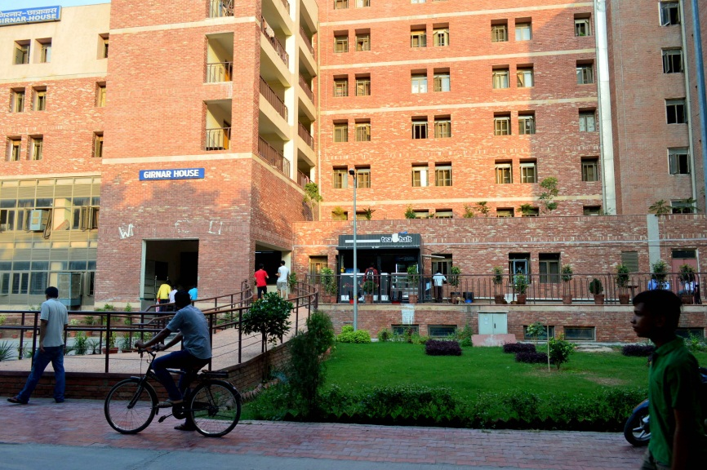
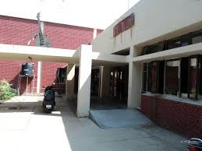
Hostels
There are 13 hostels (11 for boys and 2 for girls), There are also apartments for married students. All the hostels are named after mountain ranges in India.
Student Activity Center
SAC is for the extracurricular activities of the students. The SAC consists of a gymnasium, swimming pool, pool and billiards rooms, squash courts, table tennis rooms, a badminton court, a music room, a fine arts room, a robotics room and a committee room used to organise quizzing and debating events.

Slide 5
Student bodies
Board for Student Welfare(BSW)
Board for Recreational and Creative Activities (BRCA)
BRCA consists of 9 clubs: Literary Club, Debating Society (DebSoc), Dramatics Club, Dance Club, Music Club, Photography and Films Club (PFC), Indoor Sports Club (ISC), Quizzing Club (QC), the Fine Arts and Crafts Club (FACC)

Slide 6
Programs
Undergraduate programs
IIT Delhi offers a Bachelor of Technology in nine areas that include:
Biochemical Engineering and biotechnology
Chemical Engineering
Civil Engineering
Computer Science and Engineering
Electrical Engineering
Engineering Physics
Mathematics and Computing
Mechanical Engineering
Production and Industrial Engineering
Textile Technology.

Slide 7
Inter-disciplinary centres
IIT Delhi has 11 multi-disciplinary centres. An inter-disciplinary centre differs from a department in the fact that it deals with an overlap of two or more disciplines of engineering or science. Similar to the departments the centres also offer programs though they offer these courses only at the post-graduation level. The following multi-disciplinary centres are located in IIT Delhi:
Centre for Applied Research in Electronics (CARE)
Centre for Atmospheric Sciences (CAS)
Centre for Biomedical Engineering (CBME)
Computer Services Centre (CSC)
Centre for Energy Studies (CES)
Educational Technology Services Centre (ETSC)
Industrial Tribology, Machine Dynamics and Maintenance Engineering (ITMMEC)
Instrument Design Development Centre (IDDC)
Centre for Polymer Science and Engineering (CPSE)
Center for Natural Resources and Environment
Centre for Rural Development and Technology (CRDT)
National Resource Centre for Value Education in Engineering (NRCVEE)
Transportation Research and Injury Prevention Programme (TRIPP)

Slide 8
Notable alumni
Kiran Seth, founder of SPIC MACAY
Avinash Kumar Agarwal, mechanical engineer, Shanti Swarup Bhatnagar laureate
Soumitro Banerjee, electrical engineer, Shanti Swarup Bhatnagar laureate
Manvinder Singh Banga, Former Chairman, Unilever
Binny Bansal, Co-founder of Flipkart
Sachin Bansal, Founder of Flipkart
Swami Mukundananda,Spiritual Teacher
Kiran Bedi, first female IPS officer of India
Chetan Bhagat, Indian novelist
Vikrant Bhargava, Co-founder, Partygaming
Somnath Bharti, Lawyer and politician
Yogesh Chander Deveshwar, Chairman at ITC

Slide 9
Research
Current areas of Doctoral and post-doctoral research include study of structure and properties of fibres and fibrous materials,
Analysis and design of yarn and fabric formation systems,
Mechanics of production processes,
Comfort properties of textiles,
Optimization and mechanism of dyeing and preparatory processes,
Eco friendly processing, micro encapsulation, antimicrobial finishes, nanotechnology applications, plasma treatment, design of technical textiles,
Smart and innovative textiles, electro conductive textiles, medical textiles and tissue engineering, polymer composites and apparel engineering.

Slide 10
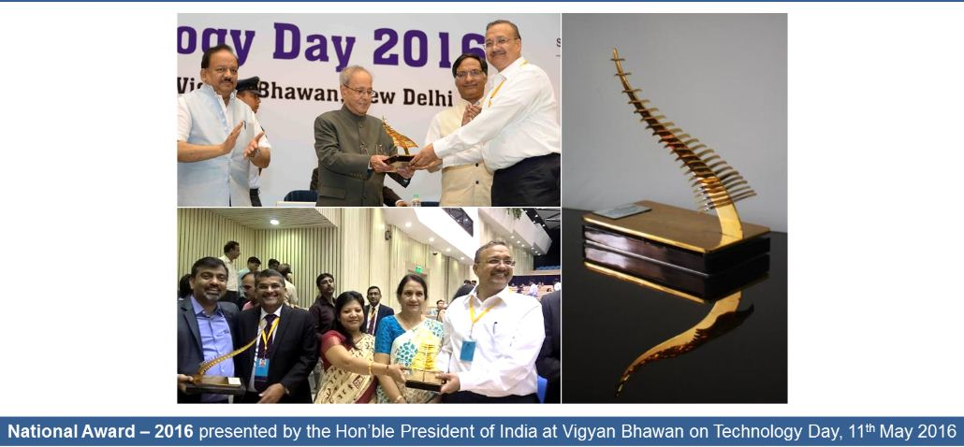
For the successful commercialization of indigenous technology was presented to SMITA Research Lab, IIT Delhi for the commercialization of N9 Pure Silver; developed jointly with partners M/s RESIL Chemicals Private Limited and ARCI, Hyderabad

Slide 11
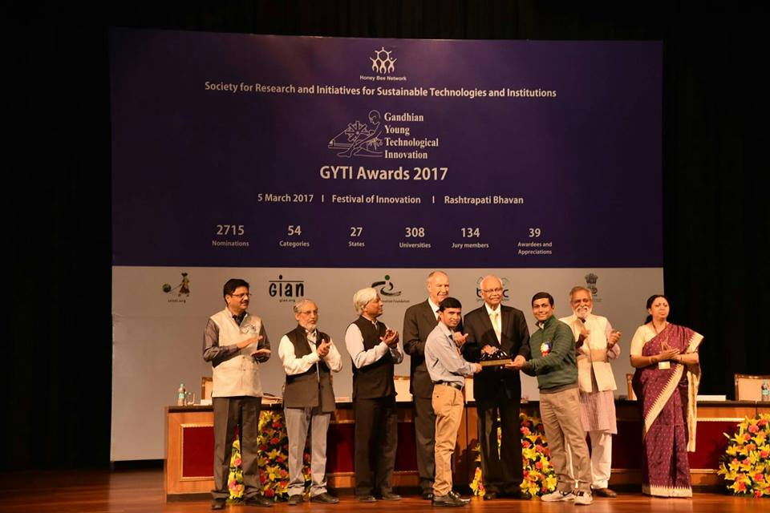
Gandhian Young Technological Innovation (GYTI) award. It is organised by Rashtrapati Bhavan to encourage young researchers.

Slide 12
THANKS

